Slide 1
ImsMetabolitesFinder
Software tools for identifying chemicals from IMS result file.
Presenter: Jian Ma, Post Bachelor Research Associate, PNNL

Slide 2
My Goals
Develop algorithms to automate metabolites search and characterization in IMS analysis. Relieve the pressure on reliance on human eye and excel sheet.
Develop metabolites analysis software libraries that can be shared in other informatics software development.
Develop part of an analysis pipeline for a more integrated exposome analysis for the metabolites team.

Slide 3
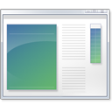
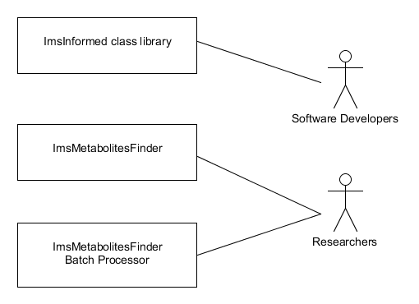
Topics
Introduction to 3 IMS&Metabolites Software Utilities
Algorithm overview and user guide

Slide 4
ImsMetabolitesFinder Summary
ImsMetaboltiesFinder.exe
A command line tool that searches for the presence of a target molecule inside a UIMF file. The target mobility(K0) and cross sectional area(A) can be computed with varying drift tube voltages. Flexible target, a chemical formula or a given Mz can serve as the search target.

Slide 5
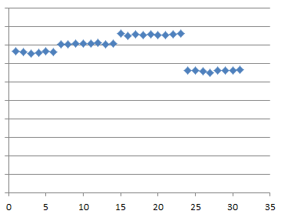
ImsMetabolitesFinder Features
Metabolites detection, mobility and cross sectional area calculation
Fast once indexed with bin-centric tables.
Flexible target, chemical formula or a given Mz value.
Mass -only and Isotopic profile feature scoring methods
Automatic voltage grouping
Outlier Rejection Algorithms to reduce errors (Important when sample size is small).

Slide 6
ImsMetabolitesFinder User Guide
ImsMetabolitesFinder 1.0.5480.23418
Copyright (C) 2014 PNNL
This application searches for the presence of a
target molecule inside a UIMF file. The target
mobility(K0) and cross sectional area(A) can be
computed with varying drift tube voltages
Usage:
Example 1: To search for Mz = 255.4 in UIMF file Example.uimf
ImsMetabolitesFinder.exe -i Example.uimf, -m M+H, -t 255.4
Example 2: to search for nicotine in UIMF file
EXP-NIC_neg2_28Aug14_Columbia_DI.uimf
ImsMetabolitesFinder.exe -m M-H, -t C10H14N2
-i EXP-NIC_neg2_28Aug14_Columbia_DI.uimf

Slide 7
ImsMetabolitesFinder User Guide
Command line Options:
-i, --input Required. Input UIMF files to be read.
-t, --target Required. IMS targeted to be identified. Could either be an
Mz value(e.g. 192.23), or empirical formula (e.g. C6H10ClN5)
-m, --method Required. Select the ionization method used for the given
experiment(M+H, M-H, M+Na)
-p, --ppm (Default: 10) Specify the PPM error allowed for MZ search.
-o, --output (Default: ) Folder where the search result and the QC file
get stored.
--isotopic (Default: False) Use isotopic feature instead of Mz only for
feature selection.
--pause (Default: False) Pause the program when result is generated.
--help Display this help screen.

Slide 8


Algorithm summary
Start
XIC extraction and summing/averaging
(ppm +/− 10)
Voltage grouping
While reading the input file frame by frame, the program group frames of similar voltages together.
Any voltage groups left?
No
NEG
Voltage Group
Voltage Group
Voltage Group
Voltage Group
Yes
Voltage Group
Yes
Linear least Square fit
Done?
claim target found in voltage group
No
Remove outliers
Feature(peak) detection
(MultidimensionalPeakFinding.dll)
Linear least Square fit
Ims scan number filter
Gamma filter
More than 3 points left?
No
NEP
Select features with highest isotopic score * 2 + intensity score
Extract the drift time and score filter’s intensity, peak shape and isotopic profile
Yes
R^2 is above threshold?
No
REJ
Remove low intensity features
Remove bad peak shape features
No
Yes
Yes
Only one feature left?
POS
Remove low isotopic features
Cross section and mobility calculation
Yes
No
Any features left
Yes
Voltage Group
Stable?
Discard voltage group
No

Slide 9
Voltage grouping
Estimate if the incoming voltage belongs to the current voltage group, using a custom classifier based on variances and voltage differences.

Slide 10
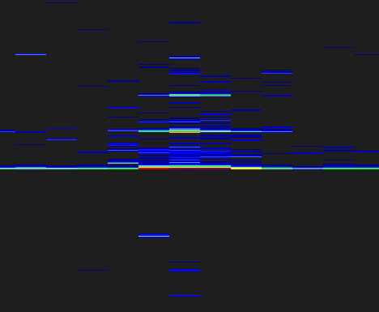
Isotopic feature

Slide 11
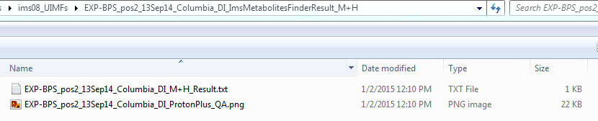
ImsMetabolitesFinder: How to read result
Result folder are written to where you specified them in the –o option

Slide 12
ImsMetabolitesFinder: How to read result
Dataset: EXP-BPS_pos2_13Sep14_Columbia_DI
Ionization method: ProtonPlus
Targeting Mz: 251.03725606
Target presence found:Variance: 0.00.
Mean Voltage 1859.21 V
score: 2410990.75
mobilityScan: 125
ImsTime: 20.38 ms
Cook's distance: 0.58
Confidence: 1.00
Target presence found:Variance: 0.00.
Mean Voltage 1795.03 V
score: 3306615.25
mobilityScan: 128
ImsTime: 20.86 ms
Cook's distance: 0.65
Confidence: 1.00
Target presence found:Variance: 0.00.
Mean Voltage 1730.97 V
score: 3627124.00
mobilityScan: 132
ImsTime: 21.52 ms
Cook's distance: 0.03
Confidence: 1.00
Target presence found:Variance: 0.00.
Mean Voltage 1666.84 V
score: 4280252.00
mobilityScan: 136
ImsTime: 22.17 ms
Cook's distance: 0.19
Confidence: 1.00
Target presence found:Variance: 0.00.
Mean Voltage 1602.73 V
score: 3881966.50
mobilityScan: 140
ImsTime: 22.82 ms
Cook's distance: 0.56
Confidence: 1.00
Mobility: 1.62 cm^2/(s*V)
Cross Sectional Area: 0

Slide 13
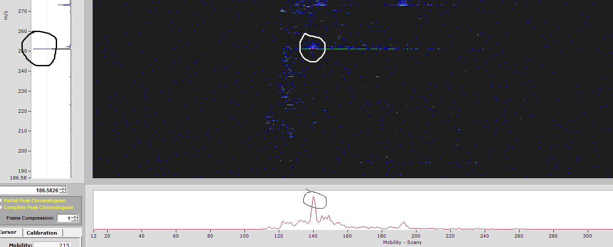
Verify the features
Target presence found:Variance: 0.00.
Mean Voltage 1602.73 V
score: 3881966.50
mobilityScan: 140
ImsTime: 22.82 ms
Cook's distance: 0.56
Confidence: 1.00
Dataset: EXP-BPS_pos2_13Sep14_Columbia_DI
Ionization method: ProtonPlus
Targeting Mz: 251.03725606

Slide 14
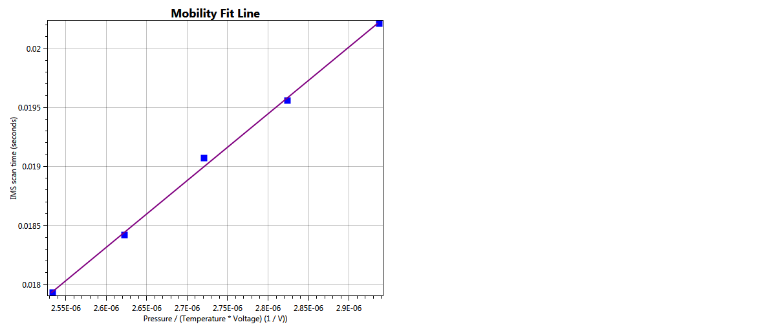
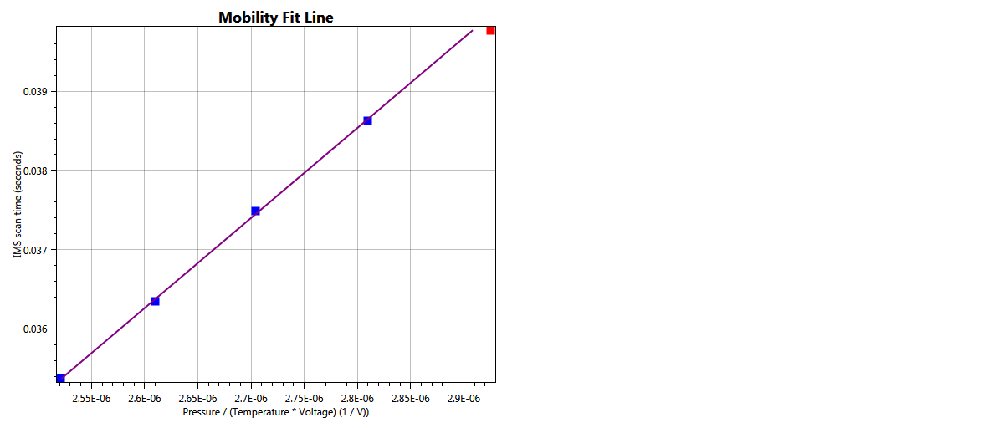
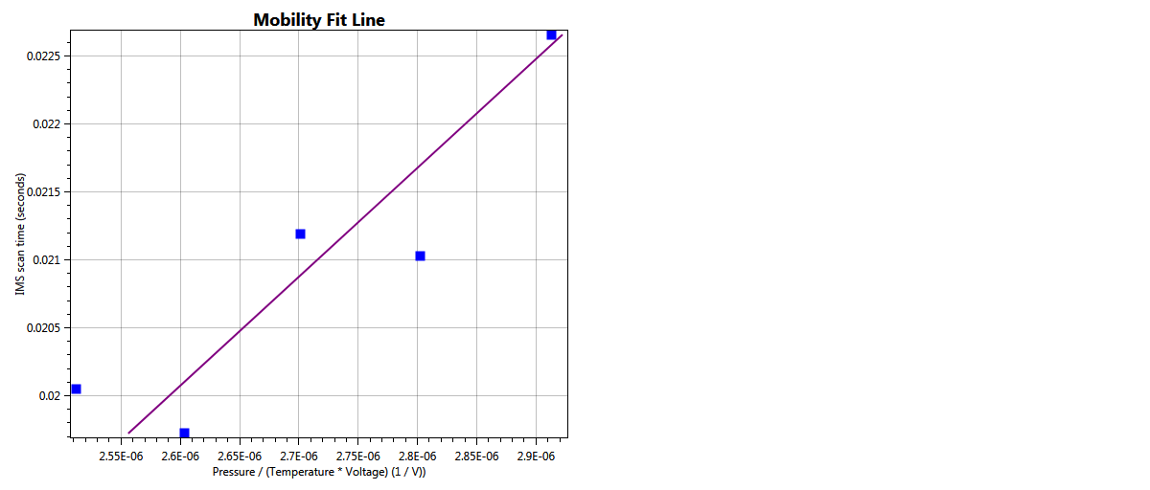

ImsMetabolitesFinder Limitations
Outlier Rejection doesn’t completely remove outliers

Slide 15
ImsMetabolitesFinder Limitations
Very specific input type. UIMF files.
Pressure,
Temperature,
Drift tube length(Currently there is no places to store it in UIMF file)
and drift tube voltage
Thus require some preprocessing.
If Agilent properitary .D format, use AgilentToUimfConverter(Ask Matt for the newer version)
Bin-centric table indexing. Speeds up following algorithms. If you don’t want to wait.

Slide 16
ImsInformed
ImsInformed is a .NET class library used by ImsMetabolitesFinder to provides target identification workflows for peptides and metabolites alike in IMS experiment runs.
Previously developed by Kevin L. Crowell, Sangtae Kim, Erin S. Baker, Richard D. Smith, Samuel H. Payne for LC-IMS-MS/Peptides. I added separated workflows for metabolites supports.

Slide 17
ImsMetabolitesFinder Batch Procssor
ImsMetaboltiesFinder.exe
This application batche processes IMS target identification using ImsMetabolitesFinder. It reads in a search spec file specifying the Dataset names to be searched and their targets files.

Slide 18
ImsMetabolitesFinder Batch Processor
ImsMetabolitesFinder Batch Processor 1.0.5480.23914
Copyright (C) 2014 PNNL
This application batche processes IMS target identification
using ImsMetabolitesFinder. It reads in a search spec file
specifying the Dataset names to be searched and their targets
files.
Usage:
Example: To use <SEARCH_FILE> on UIMF files in directory <UIMF_DIR>
ImsMetabolitesFinderBatchProcessor.exe -i <UIMF_DIR>, -s <SEARCH_FILE>

Slide 19
ImsMetabolitesFinder Batch Processor
-s, --searchspec Required. Search spec file
-w, --window (Default: False) Show the console output for each
ImsInformed workflow
-i, --input Required. specify the directory containing the uimf
files, could be recursive
-p, --parallel (Default: 1) specify the number of processes allocated to run the program.
--help Display this help screen.

Slide 20
Batch processor Features
Infer ionization method from file name
Only need to give the batch processor a directory to search UIMF files in.
Check the search spec for you before it starts processing.
Parallel processing. Specify the number of processes to use.

Slide 21
Example search Spec file
# ImsMetabolitesFinder Command-line Arguments
-p 10
# ImsMetabolitesFinder Job List
# A whitespace separated list of search specs. Note that
# could also be left blank if ionization method can be inferred from
# dataset name. For example, if the dataset name contains neg, then
# the program can be sure the ionization method is M-H
# <Dataset name> <MZ or empirical formula> <Ionization>
EXP-BPS_pos2_13Sep14_Columbia_DI C12H10O4S M+Na
EXP-BPS_pos2_13Sep14_Columbia_DI 225.41 M+H
EXP-BPS_neg2_28Aug14_Columbia_DI 125.44 M-H
EXP-24DB_pos_12Sep14_Columbia_DI C10H10Cl2O3 M+Na
EXP-24DB_pos_12Sep14_Columbia_DI C10H10Cl2O3 M+H
EXP-24DB_neg_26Aug14_Columbia_DI C10H10Cl2O3 M-H
EXP-245T_pos_12Sep14_Columbia_DI C8H5Cl3O3 M+Na
EXP-245T_pos_12Sep14_Columbia_DI C8H5Cl3O3 M+H
EXP-245T_neg_25Aug14_Columbia_DI C8H5Cl3O3
Specify ImsMetabolitesFinder Options on top.
Infer ionization method

Slide 22
The results we got so far
Small run before I got the batch processor
Small samples, 22 datasets, 7 chemicals.
Only one exposome can be found in the UIMF file.
The one result can be verified.
Complete run
All the datasets we have so far, around 1000 analyses, 342 chemicals.
Out of around 502 analyses, 6 failed because the chemical formula are not readable by the program. 110 ions were found. Out of those 110 results. 3 are false positives looking at the QA information. I manually verified several results where nothing were found, didn’t find false negatives. But there could be.
Takes around 3 days to index. Around a min to process once indexing is done.

Slide 23
On the TO-DO list.
Add compatibility option to support direct operation on .D folder
Work the samples where I cannot get good results from. Use these to improve the programs.
Bug fixes. User feedback.

Slide 24
Thanks to..
Kevin L. Crowell
Matt Monroe
Erin Baker
Tom Metz
Yehia M. Ibrahim
Sam Payne
Denis Mehinagic
Jordan Smith
Susie Crowell

